Slide 1
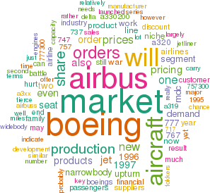
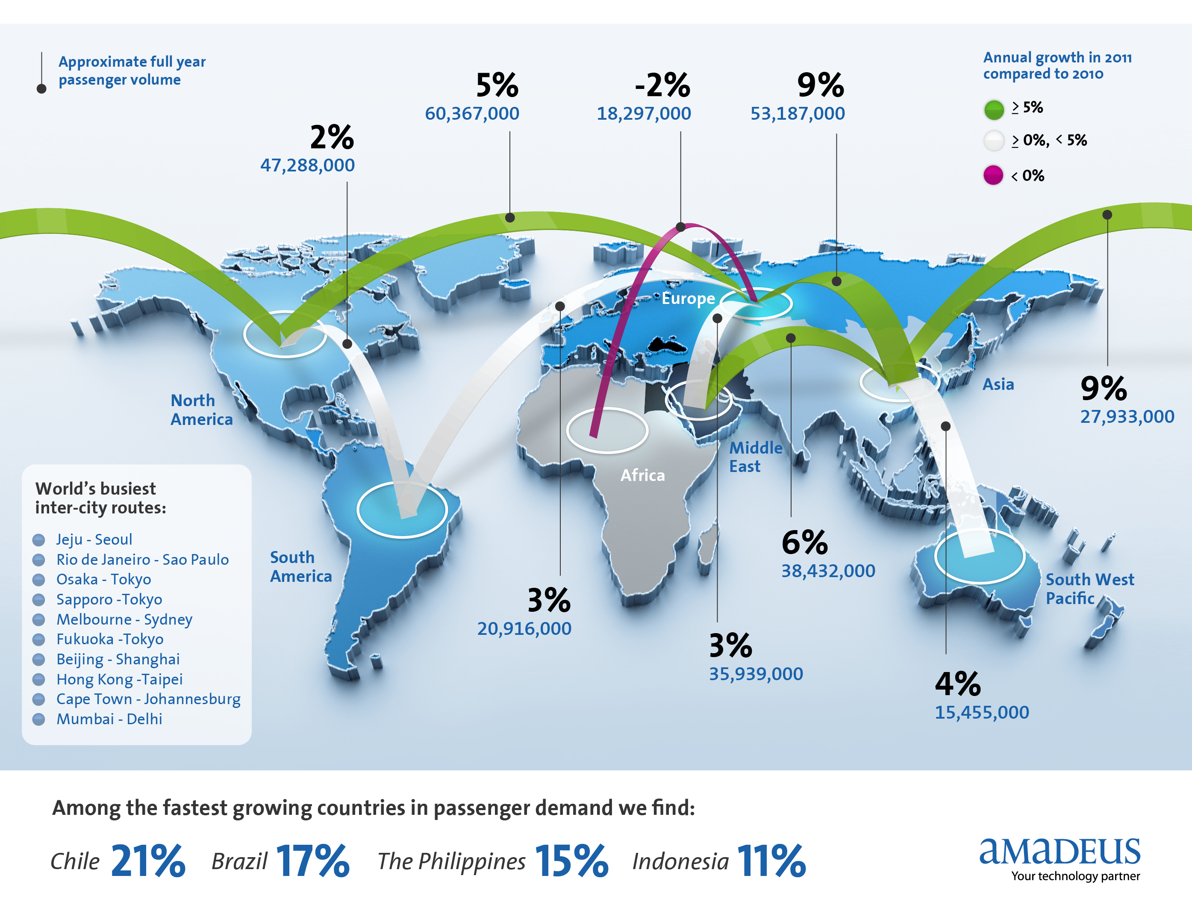
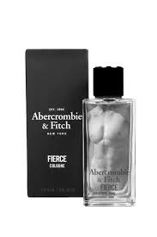
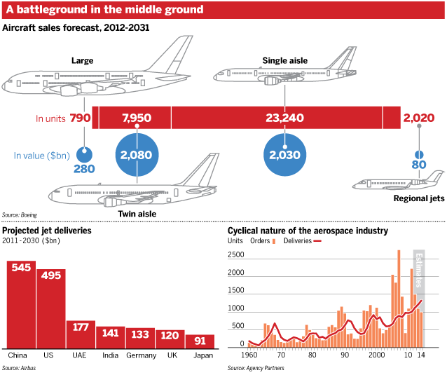
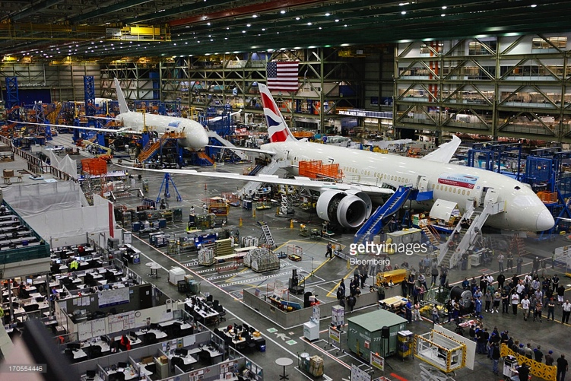
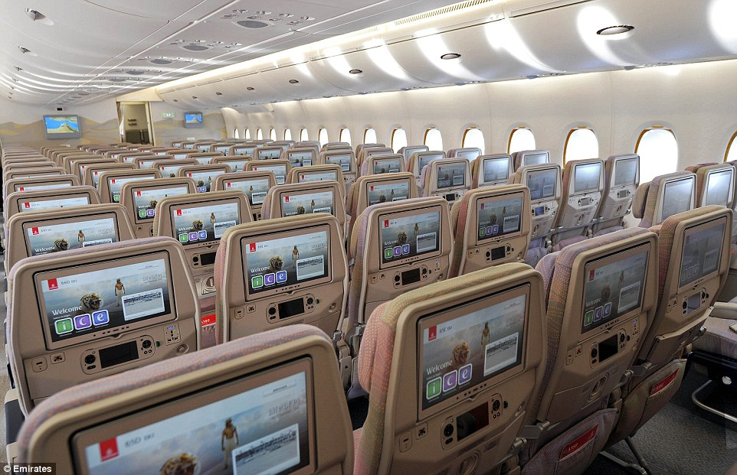
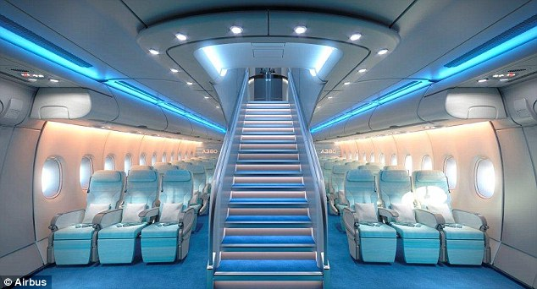
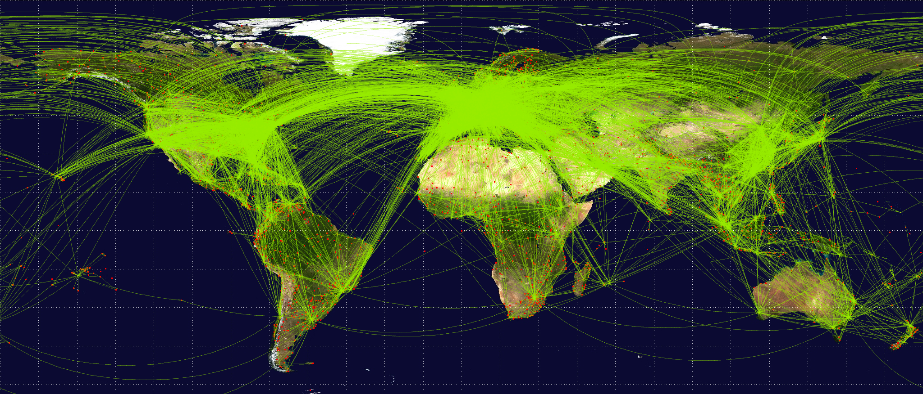
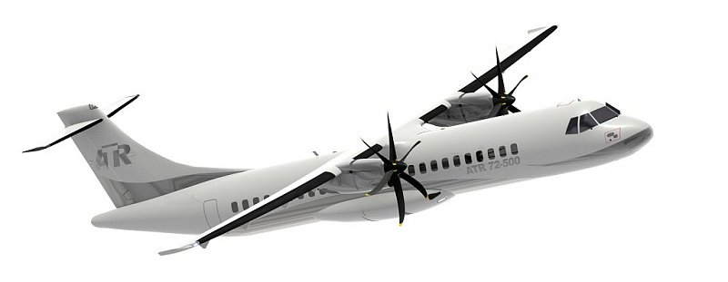
Stochastic Modelling of Capital Goods Buying
Dag Bennett & Helen Aston
The Ehrenberg Centre for Research in Marketing
The Ehrenberg Initiative
LSBU students and researchers promoting our international
programme of evidence-based marketing science
The global aircraft industry
Fast-growing markets, Fierce Competition
In the next decade, the commercial aviation industry will not only have many more jets and air travellers—but also more industry players. China is on an aggressive course to build a world-class aviaton manufacturing base. Mexico and Brazil are growing as a suppliers to the global industry. Cross-border partnerships further enmesh global players.
Looking forward, growth forecasts in new markets drastically alter today’s world map of commercial aviation—not only in sheer air traffic volume, but also the geographies where fleets will be needed to satisfy that demand. And most importantly, which companies will supply the new aircraft? In Boeing’s latest outlook, the world demand will be for 35,000 new jet aircraft by 2032, at a value of $4.8 trillion
Our Contribution
Capital Goods markets have predictable structure
The customers buy from many suppliers
But they buy more from the bigger suppliers
Market partitions are based on route length and plane size
Buying is predictable and based on underlying stochastic propensities to buy manufacturer brands
Airline buying behaviour is normal
Buying one or two planes per year is the norm.
Most airlines are light buyers of planes
Airlines buy from 2 or more suppliers (polygamous loyalty)
Sole-brand loyalty is very low
All aircraft manufacturers need more customers.
800+ airlines, most buying 10 planes per year means purchasing is highly dispersed
Smaller airlines buy smaller entry-level aircraft, creating opportunities for market penetration by new competitors
Buying is shifting to Asia, where competition is growing
What we know
1. Buying propensities for brands are predictable
2. Buying is stochastic (as-if random)
3. Buying is predicated on brand size, Wo / (1-b)
4. Brands share customers in line with
the size of other brands (DoP) bxy = D.bx
5. Portfolio buying v scale economies
6. Light buyers account for most sales
7. Stochastic choice modelling is an empirically verified approach to describing industrial market structure and competition
Predictable performance metrics
.
Implications for Researchers
Markets can be analysed in context to extend established knowledge to new areas.
Predictive power of stochastic models bridge the gap between stated intention and actual behaviour
Better modelling can generate improved theory for industiral market interactions.
Implications for Managers
Sales increases come from attracting new customers across 800+ airlines, most of which are light buyers
Marketing should be directed to all potential buyers
Frequency of purchase doesn’t vary, so strategies to capture more of a company’s capital allocations won’t work
But strategies to increase market penetration will
Loyalty to manufacturers can be bult through growth
Conventional theories of industrial buying behaviour say buyers will focus on one supplier to reduce redundancy and cost. But that was not what the evidence showed. Instead, buyers bought from 2 or more suppliers,
Only 7% were completely loyal to one supplier.
The duplication of purchase law held—brands share customers more with other big brands than with smaller brands.
Airlines buy from too many suppliers
This research makes us question all our thinking about industrial market behaviour.
Prof. Øyvind Bøhren
BI, Oslo
Buyers of |  | Who also bought
% | Boeing | Airbus | Canadair | Embraer | ATR | Other
Boeing |  | 80 | 16 | 14 | 14 | 6
Airbus | 77 |  | 10 | 15 | 15 | 6
Canadair | 44 | 33 |  | 28 | 22 | 22
Embraer | 32 | 36 | 23 |  | 18 | 0
ATR | 40 | 47 | 20 | 27 |  | 0
Other | 15 | 15 | 10 | 5
Average Dup | 42 | 42 | 16 | 18 | 17 | 7

