Slide 1
The impact of extended clinical placements on student academic achievement: preliminary findings of a collaborative research project at London South Bank University
Alan Russell, Catherine Evans & Andy Unger
London South Bank University

Slide 2
COLLABORATIVE PROJECT
Law and Social Sciences Divisions
Researching whether placements in our Legal Advice Clinic have had any positive impact on Law students’ academic performance

Slide 3
THIS PRESENTATION
Context and Operation of the LSBU Legal Advice Clinic
Methodology and Initial Results of our Research

Slide 4
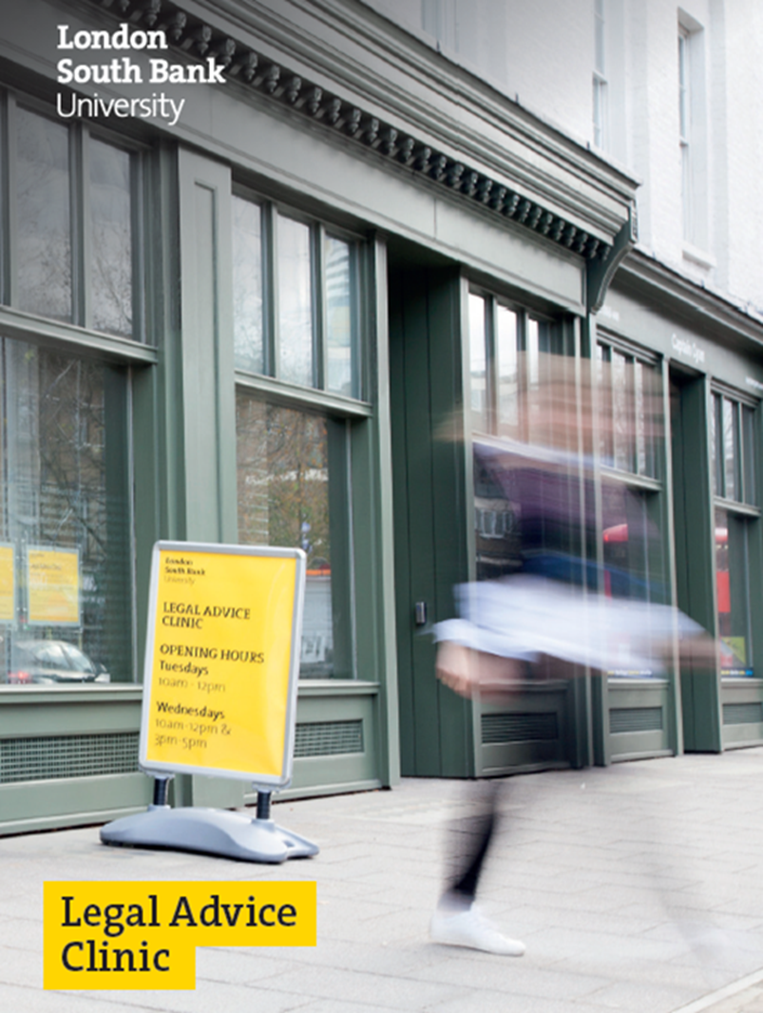

Slide 5
CONTEXT
A widening participation institution
  25% UG law students live locally in south & east London
  57% women
  65% over 21
  70% non-white
  52% in paid employment (80% working 9 hours plus)
  17% caring for at least one school age child

Slide 6

CONTEXT
Students unlikely to have links to the legal professions
  ‘Unleashing Aspiration: Final Report of the Panel on Fair Access to the Professions (Milburn , 2009)
  ‘Access to Professional Careers, a Progress Report by the Independent Reviewer on Social Mobility and Child Poverty’ (Milburn, 2012)

Slide 7

CONTEXT
ABS – Legal Services Act 2007
Information technology
Paralegals
Fewer training contracts and pupillages
University tuition fees - £9,000 PA

Slide 8




CONTEXT
‘Working in the Law’
Compulsory Year 2 undergraduate Law module
Professional & career skills
External legal work placement opportunities

Slide 9
CONTEXT
Housing & Homelessness
Family
Debt
Employment
Education
Welfare Benefits
Immigration

Slide 10
CONTEXT
Clustering
Early intervention
Impact on health and wellbeing
‘Referral fatigue’

Slide 11
CONTEXT
Genn, H. (1999) Paths to Justice: What People Do And Think About Going To Law. Oxford: Hart Publishing;
Balmer, N. (2013) Summary Findings of Wave 2 of the English and Welsh Civil and Social Justice Panel Survey, Legal Services Commission;
Pleasance, P. & Balmer, N. (2014) How People Resolve ‘Legal’ Problems: Report to the Legal Services Board

Slide 12
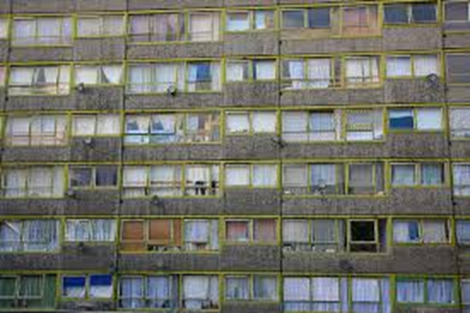
CONTEXT
Southwark ranked 23rd most deprived out of 326 local districts in England (DCLG 2015)
Demand for SWL advice enormous
Supply very limited

Slide 13
CONTEXT
Legal Aid, Sentencing and Punishment of Offenders Act (LASPO) 2012
£320 million savings PA
Legal Help Scheme slashed
Welfare benefits, debt, employment, education, immigration advice out of scope
Housing and family advice severely restricted

Slide 14

DROP IN SOCIAL WELFARE LAW ADVICE
Drop-in face to face social welfare law advice
Drop-in 3 x 3 hours a week
Staffed by students; supervised by university employed solicitors
Minimum 12 week placement
18-20 clients a week

Slide 15
PEDAGOGY
The metaphorical swamp – Schon
Principles of adult learning (andragogy) – Knowles
Directed skills acquisition – Dreyfus &Dreyfus
Habitus and cultural capital – Bordieu & Passeron

Slide 16


THE STUDENT EXPERIENCE
Notes:
Yes the students are thrown into the deep end but they are very closely supervised so more like the second picture than the first.
the students’ experience at the Legal Advice Clinic is very hands on, sometimes stressful but also as true to a legal setting as possible. For this reason the supervision supervise the students every step of the way. So although they are thrown into the deep end they are very much supported through the experience by experience professionals.
We have over 100 years’ experience between the supervisors. I worked at Southwark Law Centre and Alan works at Camden Law Centre

Slide 17
Reception
Initial details
Interview Part 1
Research enquiry
Consult supervisor
Interview Part 2
Fact-finding
Establish what client wants
Using Advice-guide and other resources
Advise the client
Agree the content of your advice to the client
Finish the enquiry
Write up an accurate case record

Slide 18
STUDENT PROGRESSION
AT DAYTIME DROP-IN
Modelling
Collaborating
Students taking control

Slide 19
DAY TIME DROP-IN
Basic information on any legal topic
Generalist advice in all areas of social welfare law (save immigration)
Signpost/referral to other local legal advice agencies and law firms
Refer to our own evening sessions

Slide 20
EVENING SESSIONS
Students shadow pro bono solicitors & barristers giving specialist legal advice in
Housing
Family
Employment

Slide 21
CLIENT OUTPUTS
3500+ clients helped

Slide 22
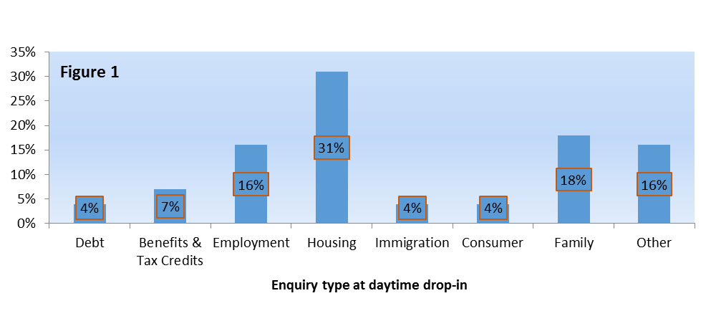
CLIENT OUTPUTS

Slide 23
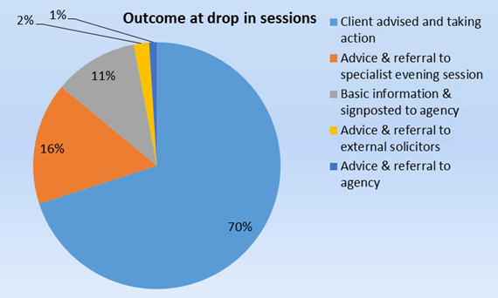
CLIENT OUTPUTS

Slide 24
CLIENT FEEDBACK
I had confidence in the advice given – 99%
Service rated excellent or good - 97%
I would recommend service to others – 99%
Advice received helped me understand my rights – 99%

Slide 25
CLIENT FEEDBACK
“Informative and relevant to the issues raised. Excellent service, would recommend to others.”
“I think this is a remarkably worthwhile service – both for members of the public concerned about their legal standing and for law students to deal with real rather than theoretical cases.”
“The people were really thorough and gave three options. It was very helpful and I feel empowered and ready to send off emails and follow this through.’
“Excellent service. I now understand what I need to do.”
“A very professional and courteous service. Pleasantly surprised at how dynamic the team of student advisers were, under the expert leadership of the professional solicitor. The service I received was exemplary and will lead to me suggesting the service to others positively”.

Slide 26
BENEFIT TO STUDENTS
In at the deep end – first point of contact
Translating client concerns into legally recognisable categories
Interview skills
Practical legal knowledge
Understanding of client care and professional ethics
Writing skills – the advice record

Slide 27
FEEDBACK
Clarify good performance by modelling and intervening.
Reflection – peer group
High quality information promptly, not just strengths and weaknesses but also constructive criticism
Peer discussion can assist as they can often explain better
Encouraging students is key
Student have the opportunity to practice these skills weekly
Use feedback to shape teaching

Slide 28
SELF REGULATION
Good feedback
Improved Learning Ability

Slide 29
WHAT THE STUDENTS SAY
Hands on practical experience, helping the public and having a safe space to learn about law in practice and gaining a lot of knowledge along the way.
The instant assessment by way of feedback - this encouraged me to identify my mistakes and so conscious of making the same mistake.
I finally found confidence and comfort in speaking to clients. I did hesitate quite a lot in the beginning but the firm and respectful guiding of the supervisors made it possible for me to stretched out of my comfort zone. I was encouraged to conduct legal research with the assistance of my supervisors and fellow students. The legal advice that I was able to give was backed up and supported by the supervisors so we could learn first hand.

Slide 30

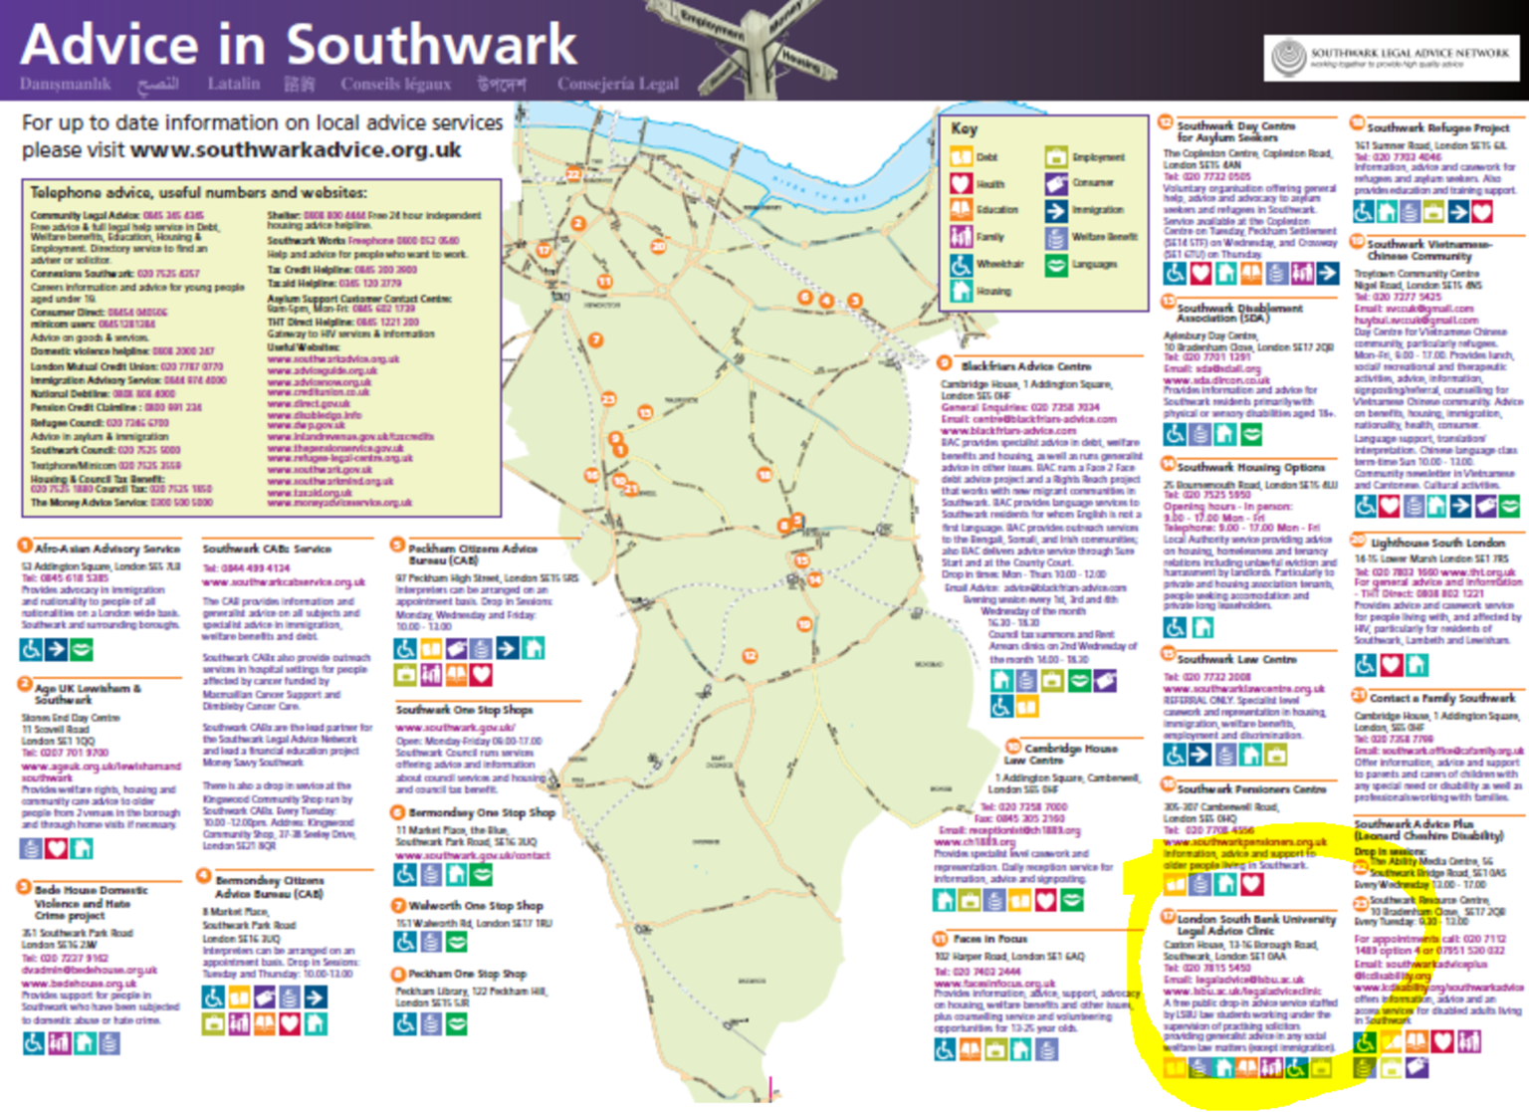


Slide 31



Drop-in
Legal Advice Clinic
Director’s Manual
1st Edition

Slide 32
THE RESEARCH
Why have a Legal Advice Clinic:
Legal Skills ?
Social Justice ?
Employability ?
All of the above ?

Slide 33
THE RESEARCH
We observed significant improvements in students’ confidence and legal professional skills over the course of a semester and wondered if this was reflected in any way in their final degree results

Slide 34
THE RESEARCH
The question was how to try and measure this and so we turned to our colleague Matthew Bond – Sociology Course Director and a specialist in Data Analytic Techniques for Social Scientists – for help ☺

Slide 35
THE RESEARCH
Our initial research is limited to an analysis of the first cohort of LLB students to have had the opportunity to work in our Legal Advice Clinic
Next steps will include analysing the next two cohorts and seeking partners for further, comparative analysis between courses with similar clinics where some but not all students have an opportunity to volunteer

Slide 36
THE INITIAL RESULTS
A simple comparison between Clinic and Non Clinic students showed that the Clinic students had a 7.22 % better final average grade.
However, applicants to the clinic are selected on merit by application and interview

Slide 37
THE INITIAL RESULTS
To account for this Matthew used a multivariate linear regression model to control for first year average grades.
The results show that clinic students still had a better final average grade than non-clinic students – 3.72% better
(smaller but still statistically significant)

Slide 38
THE INITIAL RESULTS
Of course, there might be some other unmeasured differences between students who participated in the clinic and those who didn't, other than ability as measured by first year average grades

Slide 39
THE INITIAL RESULTS
Next steps:
Review and refine method
Analyse three LSBU cohorts
Analyse three institutions with similar clinics

Slide 40
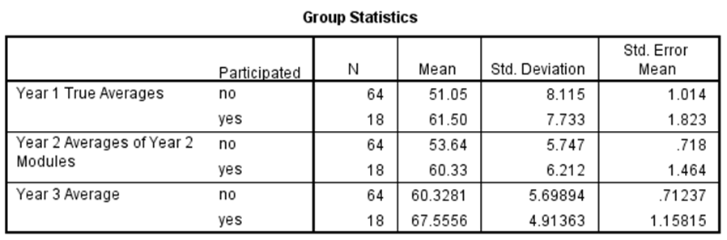
THE INITIAL RESULTS

Slide 41
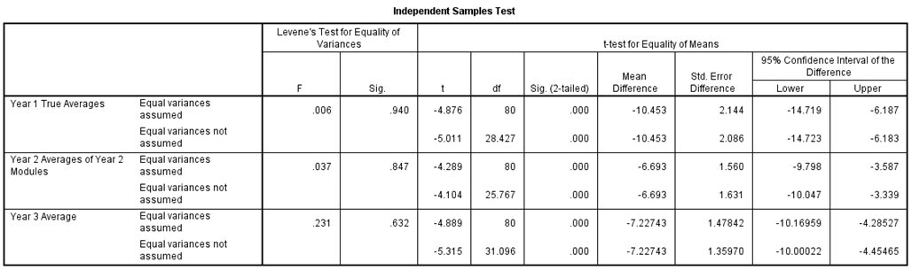
THE INITIAL RESULTS

Slide 42
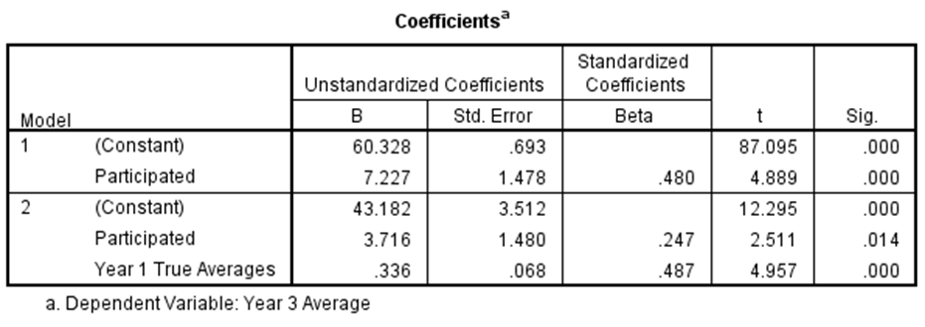
THE INITIAL RESULTS

Slide 43
CONTACTS
evansc15@lsbu.ac.uk
alan.russell@lsbu.ac.uk
ungerad@lsbu.ac.uk
www.lsbu.ac.uk/legaladviceclinic

