Slide 1
Dr Vincent Icheku
School of Health and Social Care, London South Bank University

Slide 2
Introduction
You may recall that the World Health Organisation (WHO) on the 1st of February 2016 declares Zika virus a Public Health Emergency of International Concern following the disease outbreak in Brazil.

Slide 3
Public Health Emergency of International Concern
World Health Organisation’s declaration mainly driven by the hypothesis that Zika outbreak constitutes a health risk to other countries through international spread.
The declaration was also based on the evidence of growing support for another hypothesis that increase cases of microcephaly found in new born babies is linked to the on-going Zika virus outbreak.

Slide 4
CDC2 (2016), Facts about Microcephaly,
Zika showed up in Brazil in 2014 with only 150 cases, which is a very small number for its population, compared to the outbreak in 2015.
The outbreak in May 2015, was unprecedented and is reported to have resulted in in more than 1 million cases, with 4,000 suspected cases of microcephaly, and 270 confirmed cases that health officials believe are linked to the Zika virus.

Slide 5
Increases in cases of Microcephaly
The birth prevalence of microcephaly in Brazil increased sharply during 2015–2016.
With the largest increases in the Northeast region, where Zika virus transmission was first reported (WHO, 2016).

Slide 6
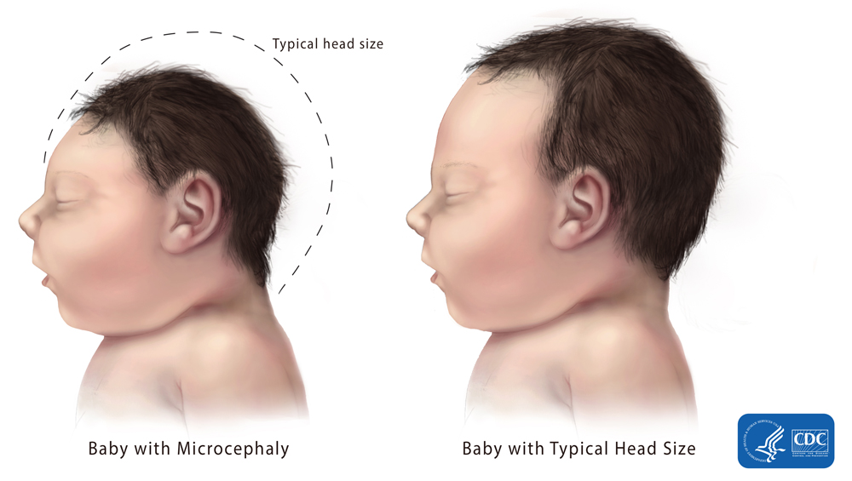
What is Microcephaly?
A rare congenital disease that is linked with incomplete brain development
It causes babies to be born with unusually small heads and, in the majority of cases, brain damage

Slide 7
WHO (2017) recently reported that:
Zika virus linked to microcephaly has now been reported in 20 countries.
As many as four million people may be infected with the virus
In other words, Zika virus poses a global public health threat

Slide 8
UK may be at risk (Icheku and Icheku, 2016)
There is clear evidence of well-established association between travels and the acquisition or transmission of infectious diseases
Since the start of the Zika virus outbreak in May 2015, 5 UK travelers have been diagnosed with the disease
Between 2010 and 2014 for which data is available, an estimated 1.4 million UK citizens travelled to areas where Zika virus is prevalent.
Thus, there is the likelihood of Zika virus transmission in UK through travel.

Slide 9
Microcephaly in Africa
The African nations were recently alarmed by the World Health Organization (WHO) report confirming an outbreak of the Zika virus on the African island chain of Cape Verde.

Slide 10
WHO (2016) tests confirmed
Two hundred cases of Zika virus with 7,557 suspected cases
Report linked cases to microcephaly for the first time in Africa

Slide 11
Cape Verde
Cape Verde is an Atlantic archipelago island that is about 350 miles (570km) west of Senegal
The island has historic ties to Brazil.

Slide 12
East African Link
You may also recall that Zika was first discovered in East Africa in 1947
With no known link to brain or birth defect until the WHO reported cases in May 2016.

Slide 13
Conclusion: 3 key questions for debate:
What is the definitive connection between Zika virus and microcephaly?
Is mosquito-borne infection the cause of the defects in babies born to Zika-virus-infected mothers?
If Zika virus is the definitive culprit in the cases of microcephaly, why are there no similar birth defect epidemics in Africa where Zika virus existed for over 70 years?

Slide 14
Current study and themes that emerged from literature reviews informing recent publications
Possibility of chemical, Pyriproxyfen, used in a State-controlled programme aimed at eradicating disease-carrying mosquitoes
Possibility of existence of poverty and inequalities in the North Eastern Brazil, currently ignored in the microcephaly narrative
Possibility of herd immunity occurring in Africa that may have provided protection against the Zika virus infection.

Slide 15
Funding and collaborative Requirements
To carry out a large scale systematic review that will address the above questions
The reviews must aspires to the rigor of a Cochrane review and quality standards

Slide 16
Bibliography
CDC2 (2016), Facts about Microcephaly, http://www.cdc.gov/ncbddd/birthdefects/microcephaly.html
ECDC (2016) Communicable disease threats report,European Centre for Disease Prevention and Control (ECDC), http://ecdc.europa.eu/en/publications/Publications/communicable-disease-threats-report-23-july-2016.pdf(Online access, March 2016)

Slide 17
Bibliography
Icheku, V. (2016) Exploration of Zika Virus Travel-related Transmission and a Review of Travel Advice to Minimise Health Risks to UK Travellers, Universal Journal of Public Health Vol. 4(4), pp. 203 – 211
Icheku V. (2016) A review of the evidence linking Zika virus to the developmental abnormalities that lead to microcephaly in view of recent cases of birth defects in Africa. Journal of MPE Molecular Pathological Epidemiology No.1:6(Vol.1) 28 Oct 2016 http://molecular-pathological-epidemiology.imedpub.com/a-review-of-the-evidence-linking-zika-virus-to-the-developmental-abnormalities-that-lead-to-microcephaly-in-view-of-recent-cases-o.pdf
Icheku, V. (2017) “Is Zika virus is the definitive culprit in the cases of microcephaly?” Lambert Academic Publishers, Germany

Slide 18
Bibliography
Physicians in the Crop-Sprayed Towns (2016) Dengue-Zika, microcephaly, and mass-spraying with chemical poisons, Physicians in the Crop-Sprayed Towns. http://www.reduas.com.ar/wp-content/plugins/download-monitor/download.php?id=109, (Online access, February 2017)
Robinson, C. (2016) what did Brazilian public health researchers really say about Zika, pesticides, and birth defects? http://gmwatch.org/news/latest-news/16741(Online access, February 2017)

Slide 19
Bibliography
WHO (2016), WHO Director-General summarizes the outcome of the Emergency Committee regarding clusters of microcephaly and Guillain-Barré syndrome, http://www.who.int/mediacentre/news/statements/2016/emergency-committee-zika-microcephaly/en/ (Online access, February 2016)
World Health Organisation (2017) Situational Report: Update, http://apps.who.int/iris/bitstream/10665/254714/1/zikasitrep10Mar17-eng.pdf?ua=1(Online access, January 2017)

