Slide 1
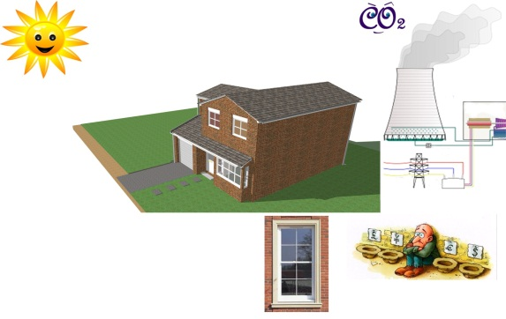
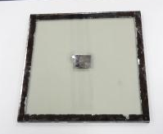
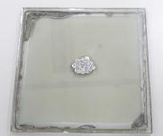
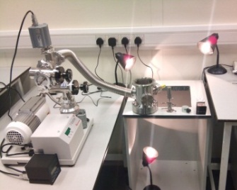
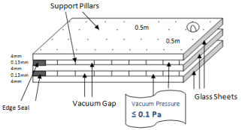
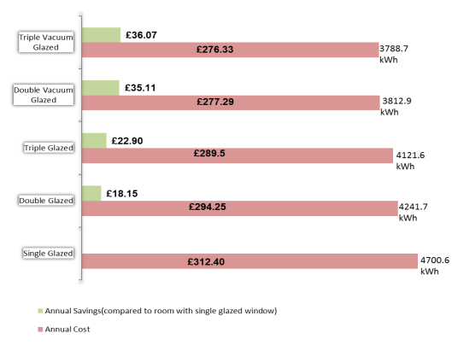
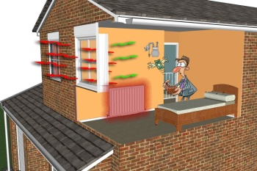
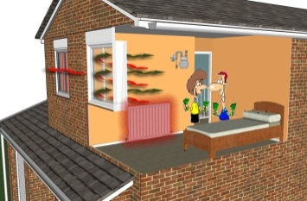
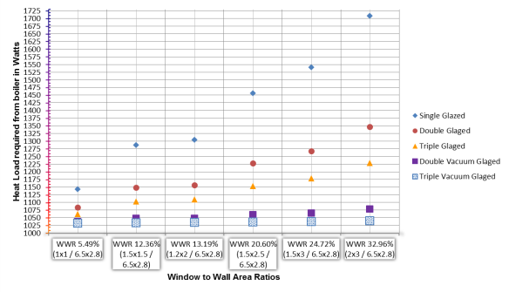
Advancement in the Vacuum Glass Sealing Materials and Heat Load Performance Predictions of Triple Vacuum Glazing
Saim Memon & Philip. C. Eames
Centre for Renewable Energy Systems Technology (CREST),
School of Electronic, Electrical and Systems Engineering
Loughborough University, Loughborough, LE11 3TU
S.Memon@lboro.ac.uk
Introduction
Results- Experimental Analysis
Heat loss through the windows of solid wall dwellings/buildings is one of the factors contributing to high energy consumption for space heating resulting in excessive carbon emissions which lead to climate change.
The fabrication of vacuum glazing are either having issues with the cost such as indium or the use of hazardous materials such as lead based solder glass. A cost effective sample of the vacuum glazing using glass metallic fusion as sealing material, as shown in figure 3, have been fabricated which yet need under investigation. The achievable pressure at the cavity of double vacuum glazing achieved is in between 1.15Pa to 1.49Pa. This pressure can be reduced by modifying the pump out mechanism. The vacuum glazing system is designed at Loughborough University shown in figure 4.
Heat loss from conventional glazings can be reduced down to low levels by retrofitting triple vacuum glazing.
Aim of Research
Fig 4: Fabricated sample using new edge sealing material
To design, simulate and develop triple vacuum glazing having cost effective hermetic edge sealing solution in order to achieve the heat transfer coefficient mid-pane U_{g} value down to 0.5 W/(m².K).
Results- Theoretical Analysis
A room of a solid wall dwelling was modelled and simulated with the design parameters given in Memon & Eames (2012). It was predicted that the annual energy consumed through the LTHW boiler in kWh when using triple vacuum glazing was substantially reduced with good cost savings compared to conventional glazing as shown in fig 1. It was also simulated that using vacuum glazing’s increasing the window to wall area ratio make a slight difference in heat load while using conventional glazing’s the heat load increases gradually as shown in fig 2.
Fig 3: The newly developed pump-out system at CREST for the fabrication of triple vacuum glazing
Conclusion & Future Work
A room of a solid wall dwelling was modelled and simulated. It was predicted that significant energy savings can be made and the window to wall area ratio can be increased with minimal increase in heat load when using triple vacuum glazing.
➲ The experimental work indicates that a new low cost hermetic material for edge sealing is possible and mid-pane U values down to 0.5 W/(m².K) can be achieved.
Fig 1:Annual energy cost saving analysis of a simulated room of solid wall dwelling
Fig 2: Predicted heat load with glazings at different window to wall area ratios
Target
Acknowledgement
Work supported by Engineering and Physical Sciences Research Council (EPSRC) of the UK (EP/G000387/1) as a contribution to the Work Package 3.4 of the CALEBRE (Consumer-Appealing Low Energy Technologies for Building Retrofitting) project.

